Slide 1
FORM REGISTRATION FRAMEWORK
MAHARISHI UNIVERSITY OF MANAGEMENT
PROJECT’S COURSE : ADVANCED SOFTWARE DEVELOPMENT
TEAM : 4
TEAM MEMBERS : HUU THAI HO
THANH XUAN TA
AZEEZ BAMMEKE

Slide 2
INTRODUCTION
This framework

Slide 3
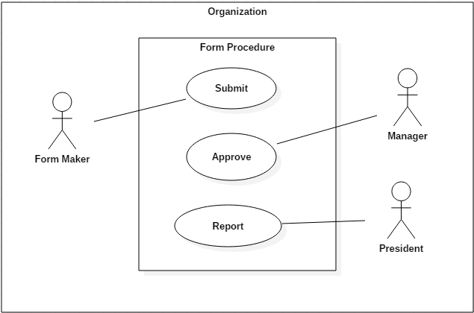
USER CASE

Slide 4
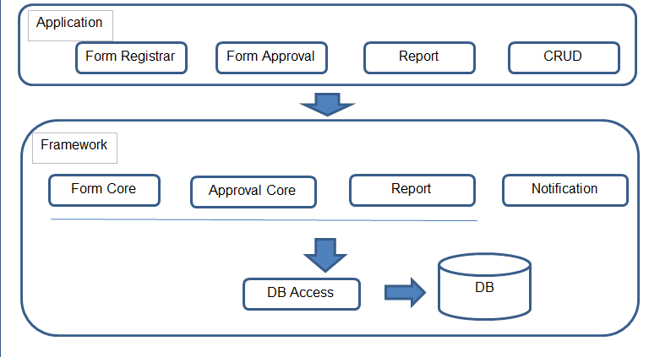
FRAMEWORK OVERVIEW

Slide 5
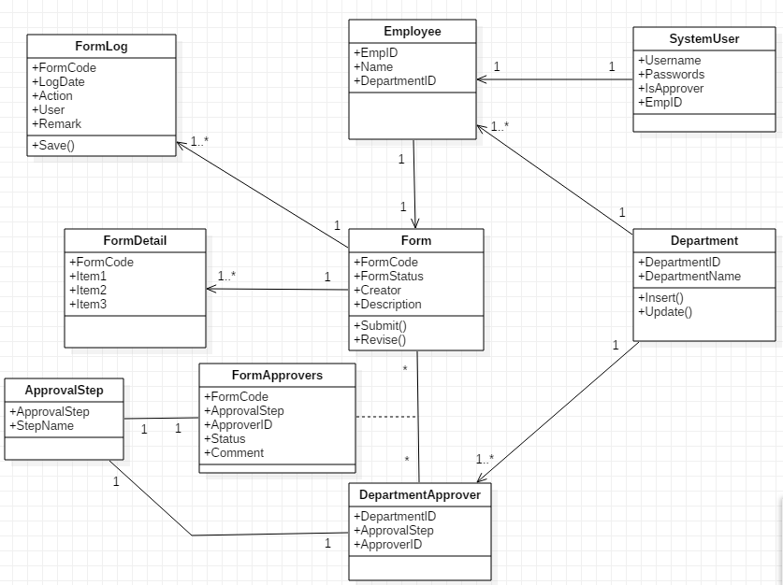
FRAMEWORK OVERVIEW

Slide 6
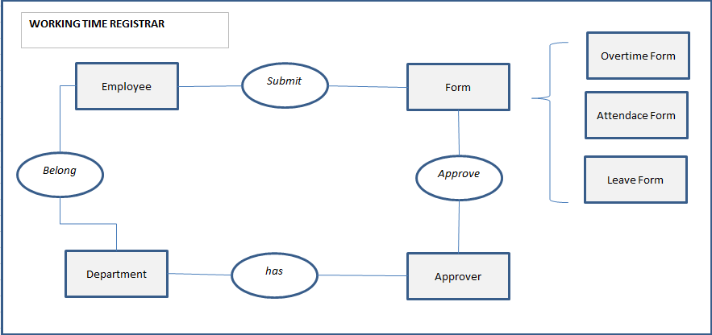
FRAMEWORK IMPLEMENTATION EXAMPLES

Slide 7
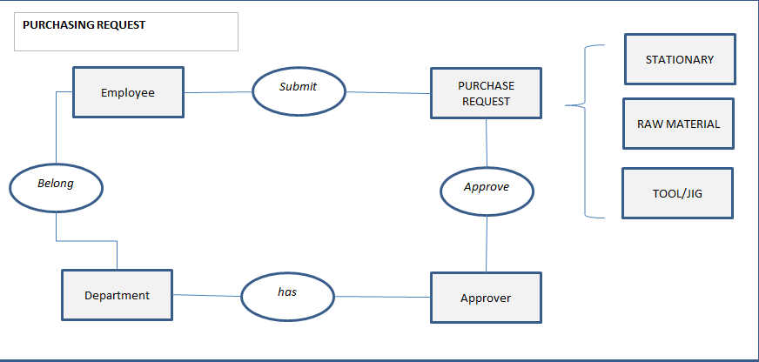
FRAMEWORK IMPLEMENTATION EXAMPLES

Slide 8
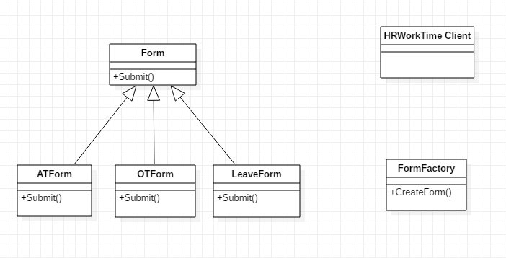
FACTORY PATTERN
Purpose : Create new Form

Slide 9
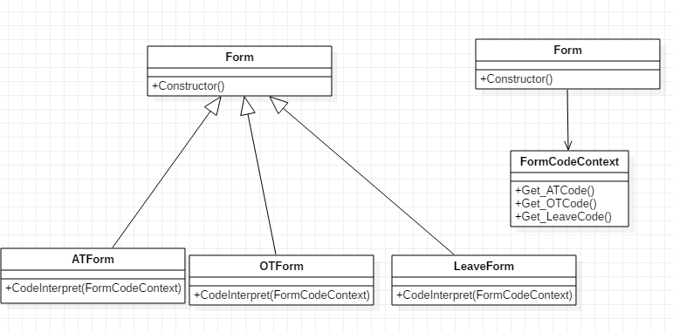
INTERPRETER PATTERN
Purpose : Form Code generation base on specific expressions

Slide 10
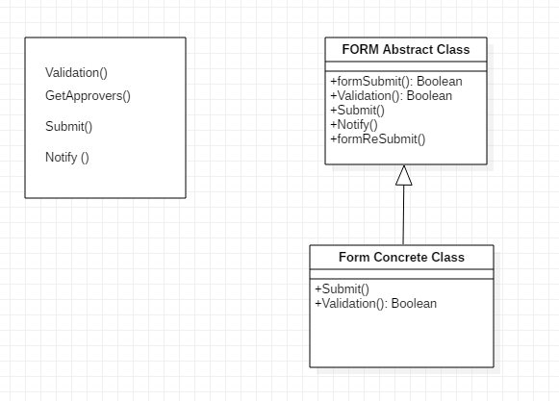
TEMPLATE METHOD PATTERN
Purpose : Form submit , Form Update

Slide 11
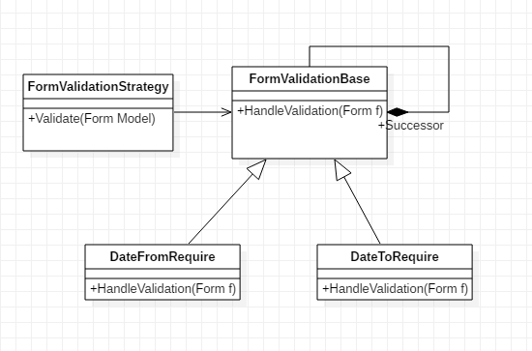
CoR PATTERN
Purpose : Form Validation

Slide 12
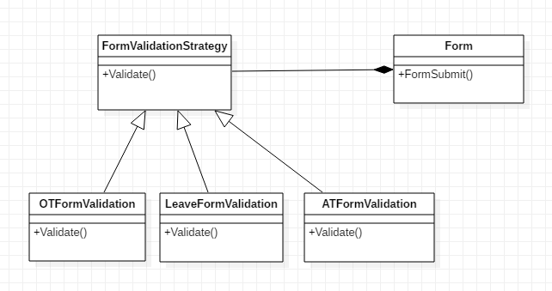
STRATEGY PATTERN
Purpose : Form Validation

Slide 13
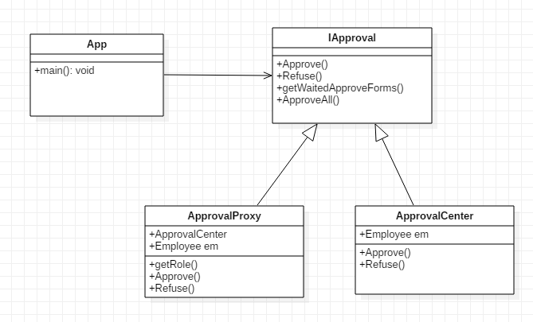
PROXY PATTERN
Purpose : Approval Center

Slide 14
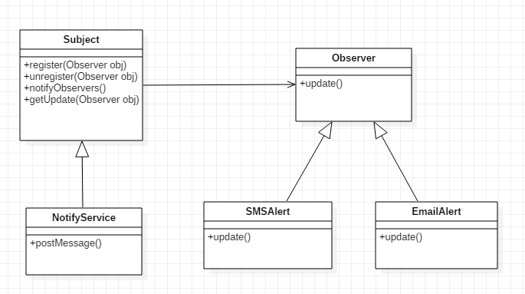
OBSERVER PATTERN
Purpose : Notification Center

Slide 15
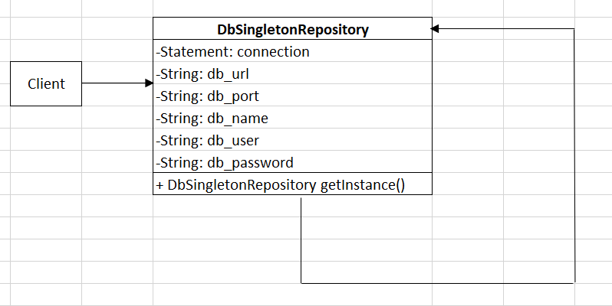
SINGLETON PATTERN
Purpose: Get instance of database connection.

Slide 16
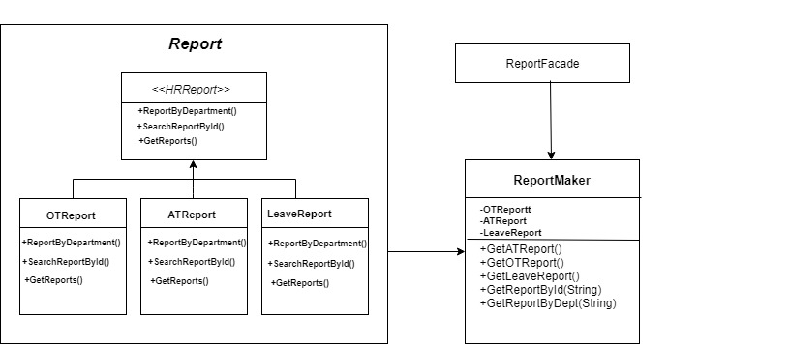
Report Maker Framework

Slide 17
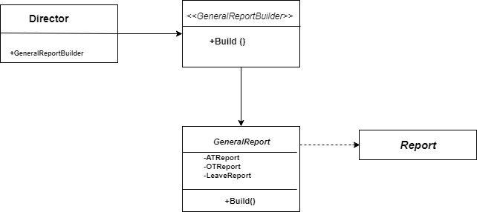
Report Builder Framework

